Slide 1
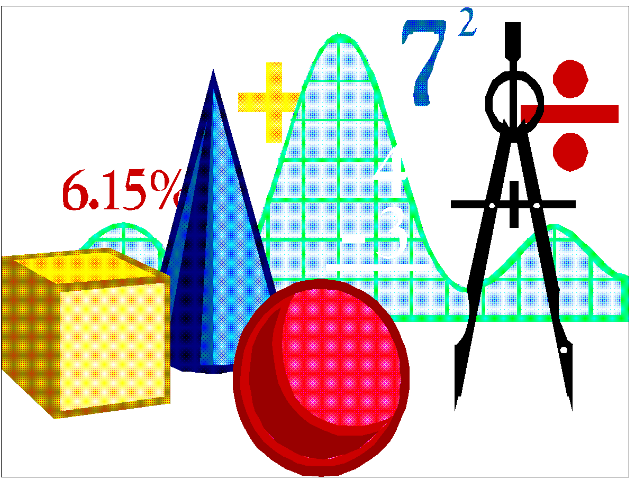
Design vs. Product Specifications: Purpose, Content & Audience
ENGR 1021 – Intermediate CAD
Detroit Mercy – Mechanical Engineering
Fall 2018 – McCall
Courtesy of Detroit Mercy – Mechanical Engineering – Fall 2019

Slide 2
The Product Design Process Design Specs at beginning Product Specs at end
Problem / Need identified
Design Specs & Criteria established
Design created
Prototype evaluated
Product manufactured
Product sold (Product Specifications)
Notes:
Starting at the top: We were taught in ENGR 1080 that we don’t create products in a vacuum. Instead, engineers respond to a need or a request.
To the right, we work from Design Specs to create products. Those design specs can be based on regulatory requirements (ISO, for instance), safety laws, customer demands, our boss, or even ourselves or our engineering co-workers. Remember, Design Specs are specific: Less than 10 lbs. Criteria are more general: Light-weight.
We are familiar with the next three steps in the design process: Create the design, build a prototype and evaluate it, and then manufacture the approved design.
What’s new is the Product Specifications, the information that helps sell the product to the end user. For consumer products, it’s the information on the “side of the box.” Think of a laptop or a cell phone or a pair of pliers – all have product information on the packaging to help consumers learn about the product and make a purchasing decision.

Slide 3
Getting from Beginning to End Rhetorical Strategy
Here
There
Q. How do I design documents that support my design from ideation to Sale #1?
Know each document’s:
Purpose
Audience
Content
Notes:
Rhetorical Strategy = Communication Plan = do the work up front to minimize re-drafting (saves time and money for you and the boss).
We did – or will do -- a rhetorical strategy in class for your Bell Crank design project.

Slide 4
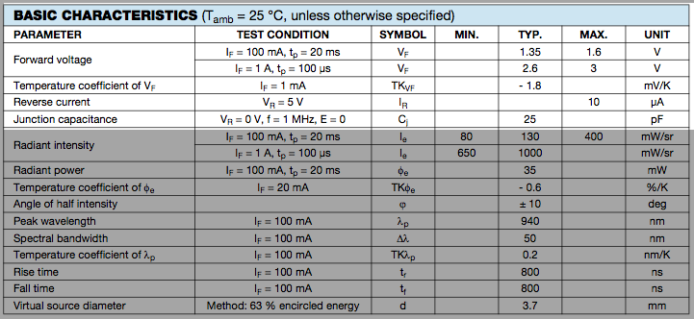
At the beginning Design Specs: Definition
List of things that must hold true or else the design is rejected.
Essentially, a go-no go list. [1]
Thanks to Dr. P. for the definition.
Notes:
Here we are at step 2 of the design process. Someone has identified a product need. Now we work from (or develop) the Design Specs.
Dr. P. explains the purpose and value of Design Specs.

Slide 5
At the beginning Design Specs: Purpose
Set parameters that:
Accomplish the purpose (i.e., solve the problem)
Save money by
Minimizing false starts
Controlling frustration
Saving time
Are based on prior knowledge (i.e., research)
Notes:
Notice that Design Specs are practical. They set limits.
Plus they are based on what came before. What’s the point of repeating mistakes made in previous designs?

Slide 6
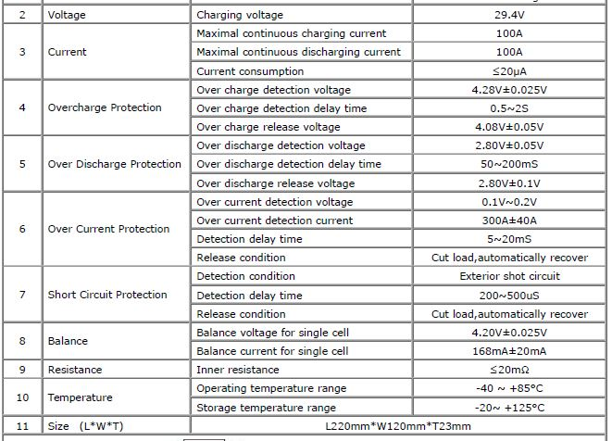
At the beginning Design Specs: Audience
Design Engineers
Technician audience
Practical
Concerned about recognition / job performance
Use jargon and short-hand
Prefer concrete examples vs. paragraphs of text
What else do we know about the people who design products?
Notes:
As we’ve heard, Design Specs are a form of communication between customer-engineer, engineer-engineer, and engineer-manufacturing floor.
We must observe and use the format and nomenclature for Design Specs.

Slide 7
At the beginning Design Specs: Content
The design must weigh less than 4 lbs.
The size of the hole must be 1.000 – 1.003 inches.
The product footprint must be less than 12 x 12
inches. [1]
Thanks to Dr. P. for the examples.
Notes:
Numbers! This is where dimensioning comes in.
With the numbers provided by dimensioning and the visuals provided by the CAD drawing, manufacture can begin.

Slide 8
At the End Product Specs: Definition
A.k.a. Product Literature
Prescribe standards for performance, safety, and quality
Describe the product and how to use and care for it
Notes:
We’ve now moved to the end of the product design cycle. We are ready to sell Product #1.
However, to help sell it, we have to provide information about what it does, its features, and so on.
Simply placing this motorized wheelchair in a box won’t sell it because consumers won’t know why it costs thousands of dollars. As engineers, we have to provide the technical descriptions that help do this.

Slide 9
At the End Product Specs: Purpose
Ensure proper use of product
Promote safety & safe practices
Limit product liability
Prolong the life of the product
Contribute to customer satisfaction
Encourage initial sale and repeat business [2]
Notes:
Here’s the value added by Product Specs.

Slide 10
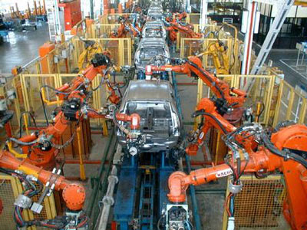
At the End Product Specs: Audience
End Users:
Customers
Designers
Contractor or manufacturer
Suppliers
Workforce
Inspectors
Regulators
Notes:
And here are many of the end users that Product Specs are designed to reach.
Notice the variety of end users. This is what makes audience analysis critical. Are you writing to a customer like your Auntie May or a safety inspector at OSHA?

Slide 11
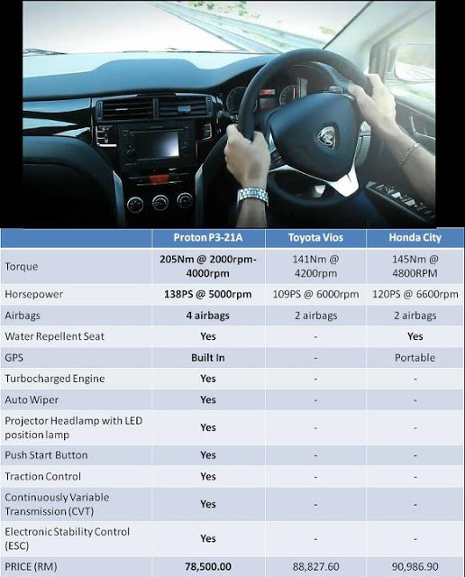
At the End Product Specs: Content
General Audience Specs
Name of product
Owner/producer of product
Photo/illustration of product
Description: Use, size, dimensions, weight
Safety warnings
Parts/materials/tool lists
Instructions for use
Date
Technician Audience Specs (in addition to above)
Methods for manufacturing, building, installing product
Materials and equipment to be used
Size, shape, weight of product
Specific testing, maintenance, and inspection procedures [2]
Notes:
Some of the data will be individual to the product, but listed in the slide are basics you will always want to include.
The photo gives car buyers a comparison of three different vehicle by providing Product Specs.

Slide 12
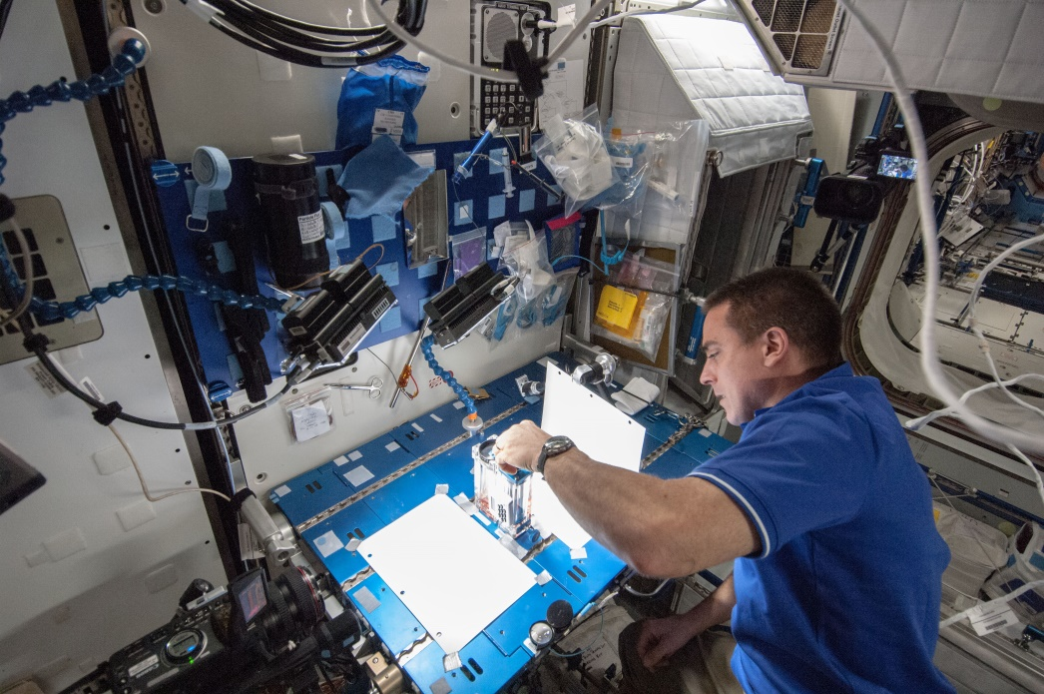
Audience & Purpose What does this Spec need to accomplish?
Help an engineer choose which component to use?
Help a consumer make a purchasing decision?
Notes:
So, here we are back at the importance of audience and purpose.
NOTE: These are both purchasing decisions, aren’t they?
The top one asks: Will your product solve my problem – or will your component fit into my existing product or system?
The bottom one asks: Why should I buy your particular bicycle?
Take time at the beginning of any project to figure out the purpose of your project (what do I need to get done?) and the audience (for whom am I writing?). Using this strategy will enhance your job satisfaction and your boss’s opinion of you and your work.

Slide 13
References
[1] Plantenberg, K., 2016, “Design Specs, Technical Drawings, and Engineering Drawings” University of Detroit Mercy, Detroit, MI. Lecture and emails.
[2] Lannon, J. M. and Gurak, L. J., 2017, Technical Communication, 14th ed., Pearson, Boston, Pearson. pp. 71, 425-431.

Slide 14
Product Spec Samples to Analyze
Notes:
Distribute and discuss samples with students.

